Slide 1


Blood Bank System
A MINOR PROJECT-I
Submitted in Partial Fulfillment of the Requirement for the Award of the Degree of
BACHELOR OF TECHNOLOGY
IN
COMPUTER SCIENCE & ENGINEERING-DATA SCIENCE
SUBMITTED TO
Rajiv Gandhi Proudyogiki Vishwavidyalaya, Bhopal (M.P.)
SUBMITTED BY
ANUJ RAJ (0176CD211026)
UMANG PRASAD (0176CD21123)
VIVEK KUMAR (0176CD211136)
UNDER THE SUPERVISION OF
Prof. Vinita Keer
Department of Computer Science & Engineering
Department of Computer Science & Engineering-Data Science
Lakshmi Narain College of Technology Excellence, Bhopal (M.P.)
December 2023

Slide 2

BLOOD BANK SYSTEM
--BY ANUJ RAJ , UMANG PRASAD & VIVEK KUMAR​

Slide 3

CONTEXT
INTRO
PROBLEM
SOLUTION
SYSTEM OVERVIEW
SYSTEM BENEFITS
SYSTEM MODEL
LANGUAGE USED
HOMEPAGE
DONOR PAGE
PATIENT PAGE
ADMIN PAGE
BLOOD STOCK PAGE
DATABASE
DIAGRAM FRAMEWORK
CONCLUSION
FUTURE SCOPES

Slide 4

INTRO
Blood banks are cornerstones of the healthcare system, ensuring the availability of blood and blood products for life-saving transfusions.
This project presents a comprehensive blood bank management system developed using Python and the Django web framework, complemented by the SQLite3 library for database management.

Slide 5
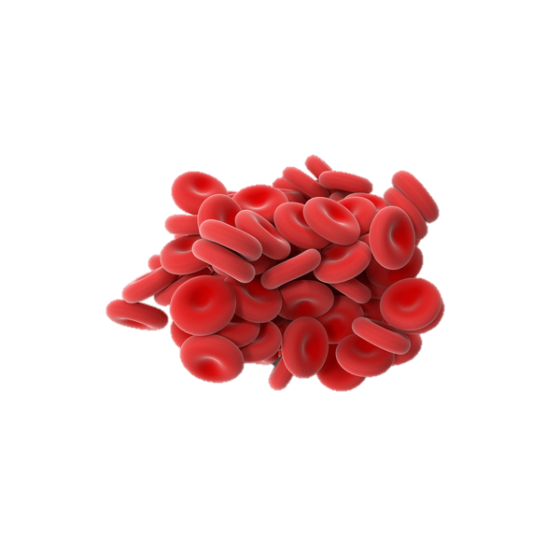
Problem
Market DEMAND
DONOR RECORDS
NO Awareness
People who need blood are increasing day by day
With the manual system , there are problems in managing the donor records.
It is not that people don’t want to donate blood but their limited knowledge they don't have any idea of blood donation.
Costs
NO AUTHORITY
High cost and black marketing in hospitals.
No valid information regarding the blood donation or managing programs
available on any of the portals.

Slide 6




Solution
Close the gap
Target Audience
Our system makes ordering medical equipment easier​
Require patient’s family can request for blood
Cost savings
Easy to use
Reduce expenses of medical supplies by eliminating the need to buy at market value​
This system gives the information they need in order to keep track of donor , patient and blood stock.​

Slide 7
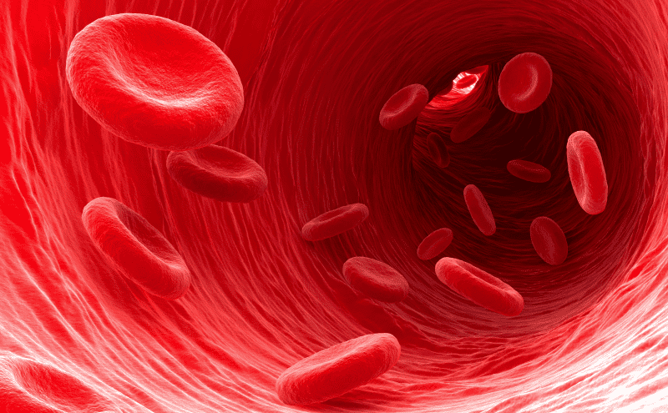
SYSTEM Overview
HOME
DONOR
This gives the good look and smooth UI design with a important message about blood donations.
This field includes donor homepage where donor can create account and make blood donations
PATIENT
ADMIN
This field includes patient homepage where allows patient can make request for blood.
Admin can verify and approve blood request and manage blood stocks.

Slide 8
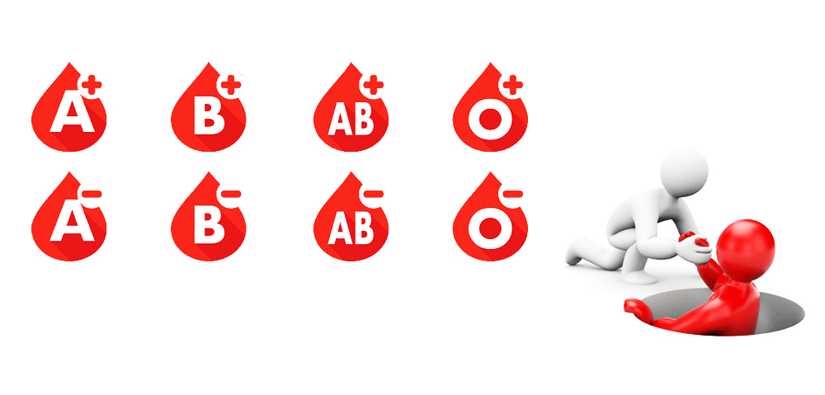
SYSTEM benefits
To make valid and informative portal about blood donations and managing system.

Slide 9

SYSTEM model
Research
We based our research on market demand and blood shortage​
Abstract
We believe our system will prevent death due to blood shortage.
Design
Simple design and easy to use ​

Slide 10

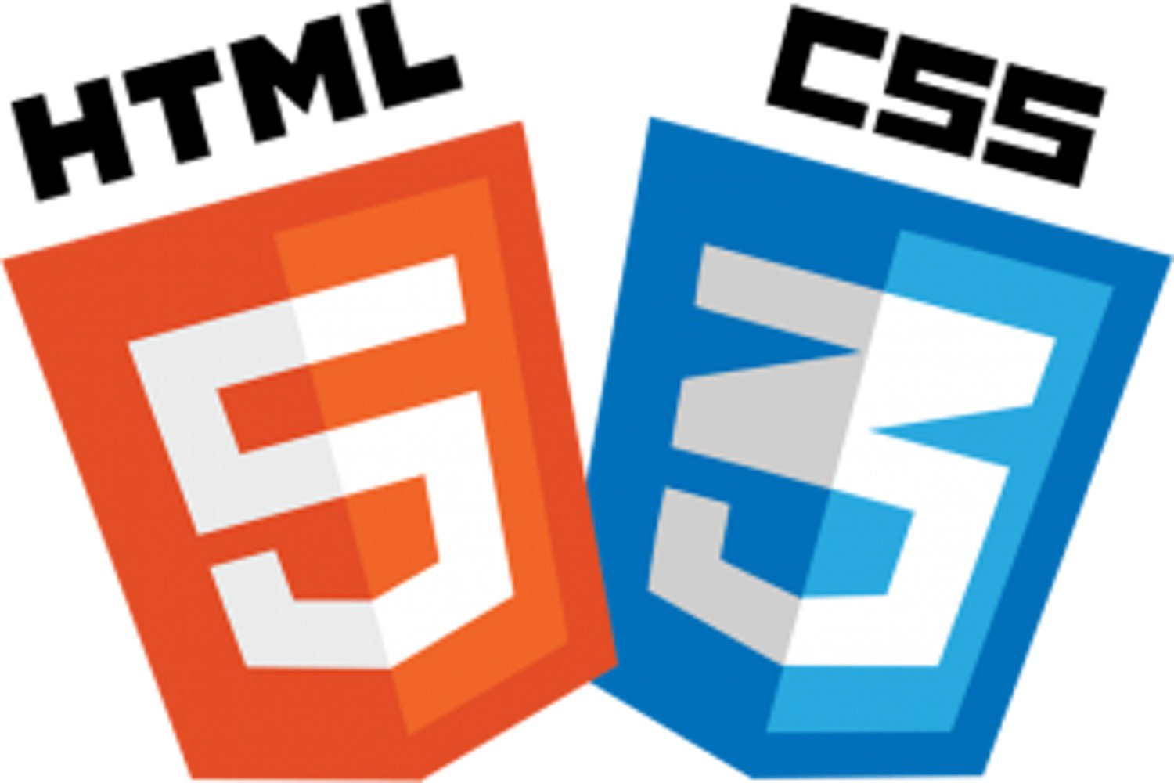
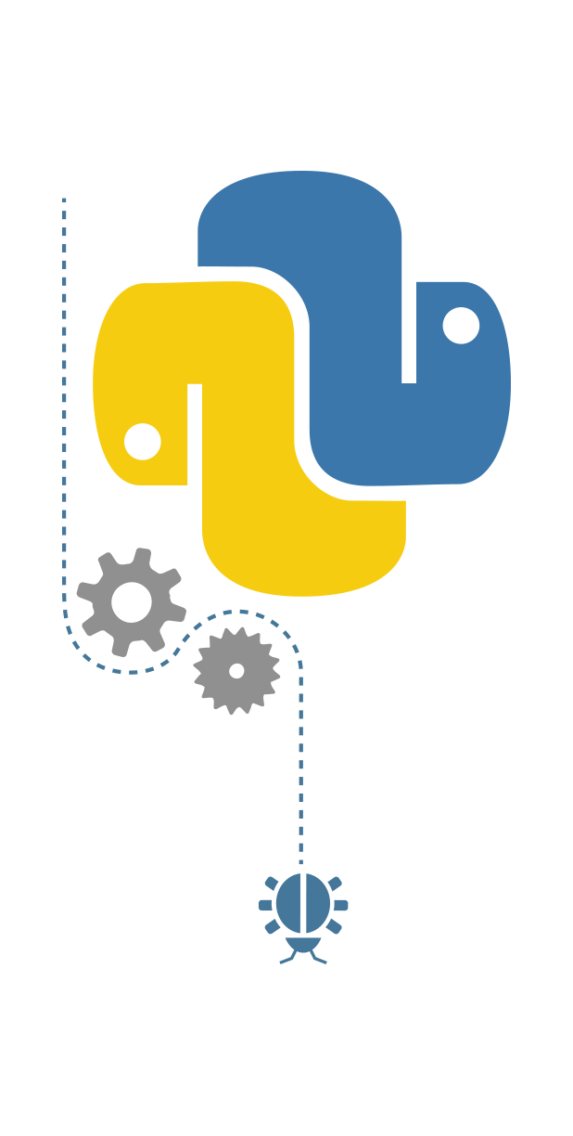

LANGUAGES USED
Python
DJANGO
Html
Css
SQLITE3

Slide 11
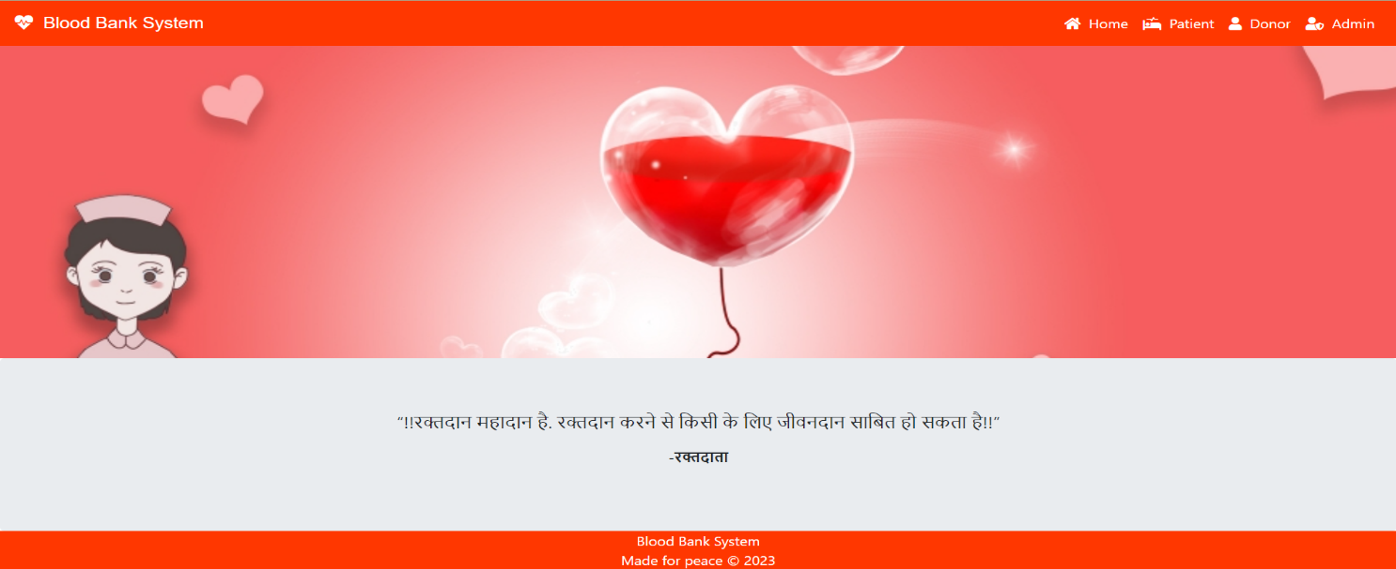
HOMEPAGE

Slide 12
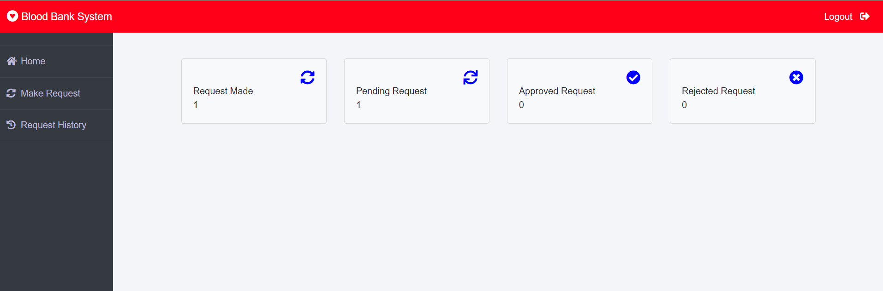
PATIENT PAGE

Slide 13
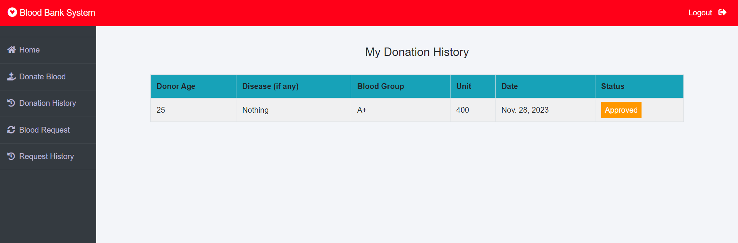
DONOR PAGE

Slide 14
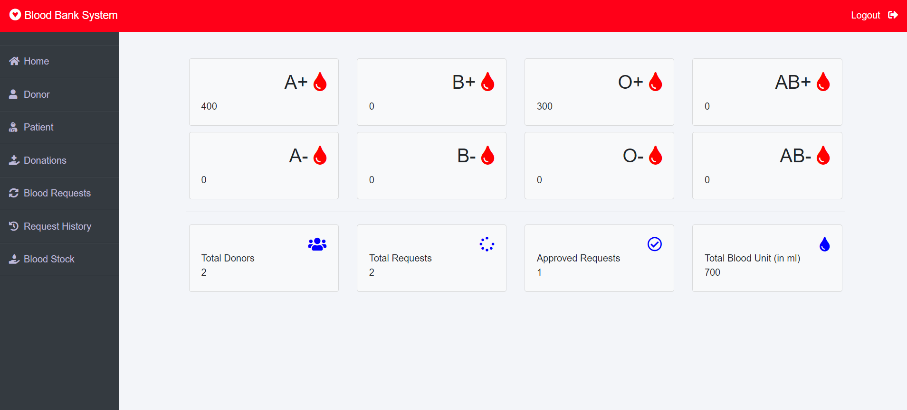
ADMIN PAGE

Slide 15
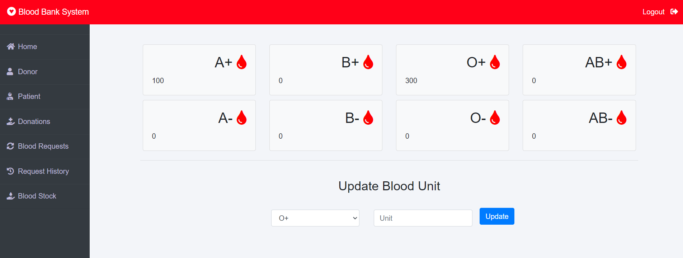
BLOOD STOCK PAGE

Slide 16
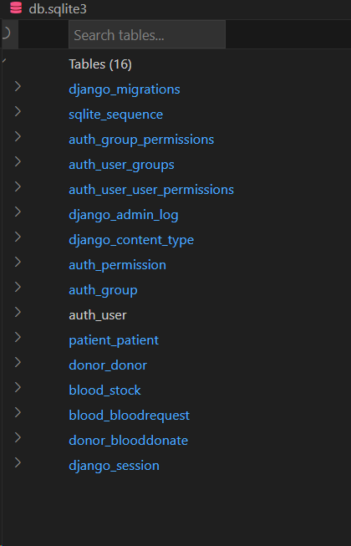
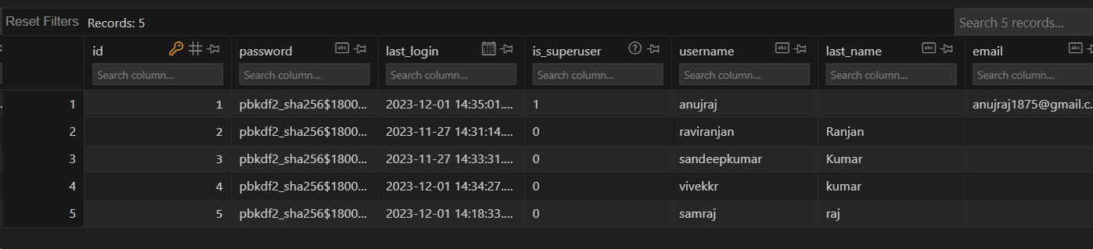
DATABASE
CONTENT Db
AUTH_USERS Db

Slide 17
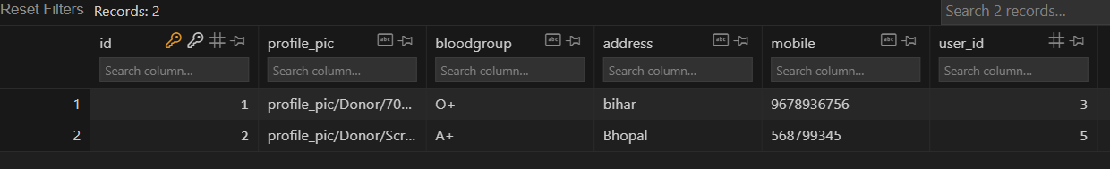
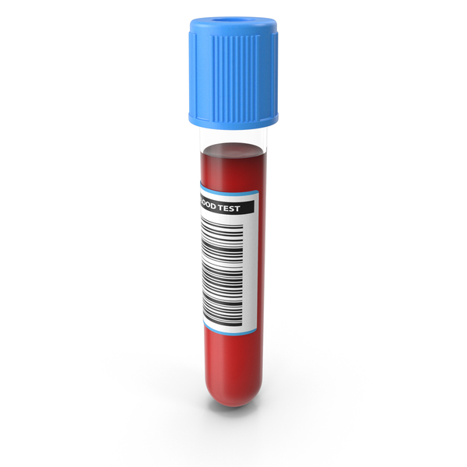
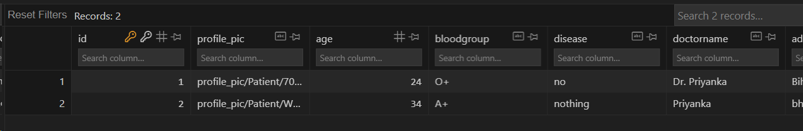
DATABASE
DONOR Db
Patient Db

Slide 18
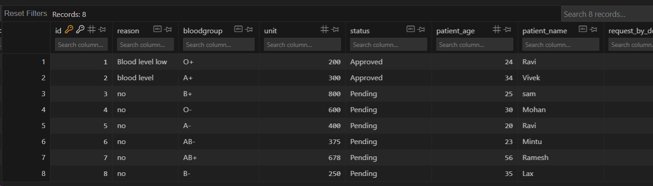
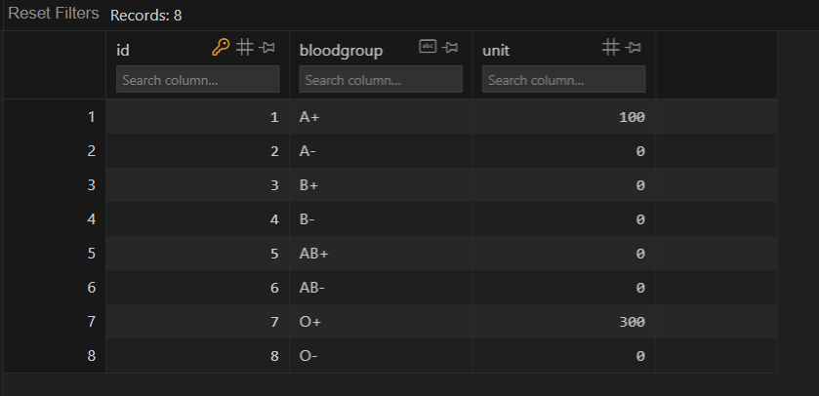
DATABASE
blood request Db
BLOOD STOCK Db

Slide 19
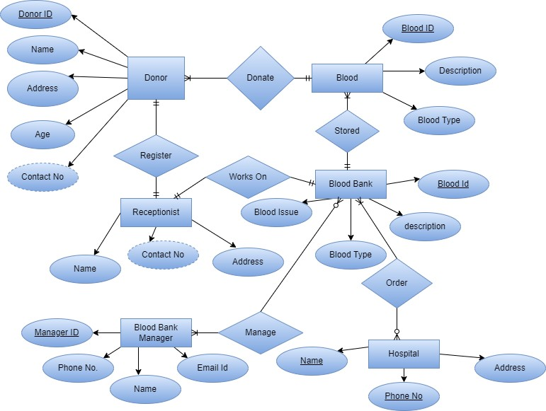
DESIGN FRAMEWORK
1. ER DIAGRAM

Slide 20
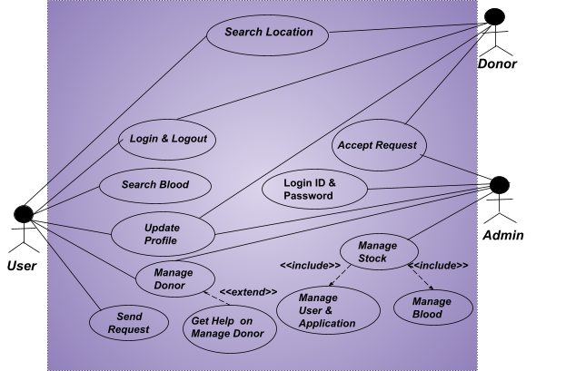
DESIGN FRAMEWORK
2. UCD

Slide 21
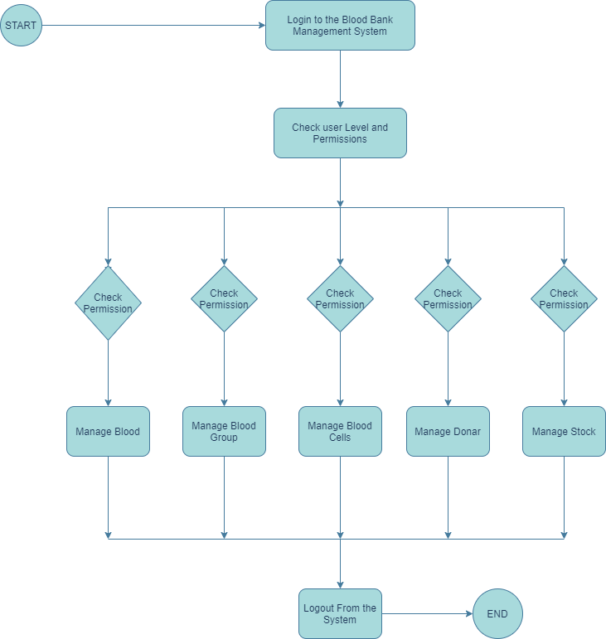
DESIGN FRAMEWORK
3. DFD
For User

Slide 22
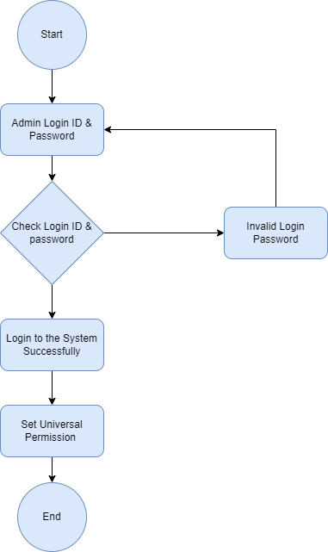
DESIGN FRAMEWORK
3. DFD
For Admin

Slide 23

CONCLUSION
The system addresses the challenges faced by traditional blood bank systems and provides a user-friendly interface for managing blood donors, patients, blood donations, and blood requests. The system also includes features for tracking blood inventory, generating reports, and managing blood bank staff.

Slide 24

FUTURE SCOPES
Mobile App
GPS
Machine
Learning
Chat
bot
Artificial Intelligence

Slide 25
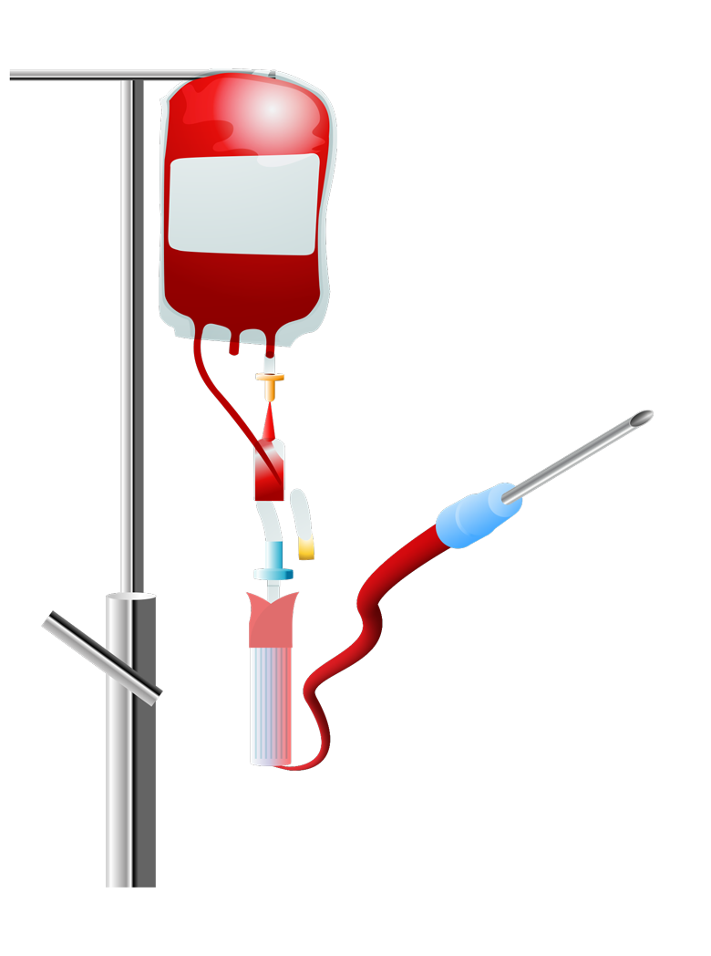
the team
ANUJ RAJ
UMANG PRASAD
Backend
(0176CD211026)
Frontend
(0176CD211123)
VIVEK KUMAR
Report Handler
(0176CD211136)

Slide 26
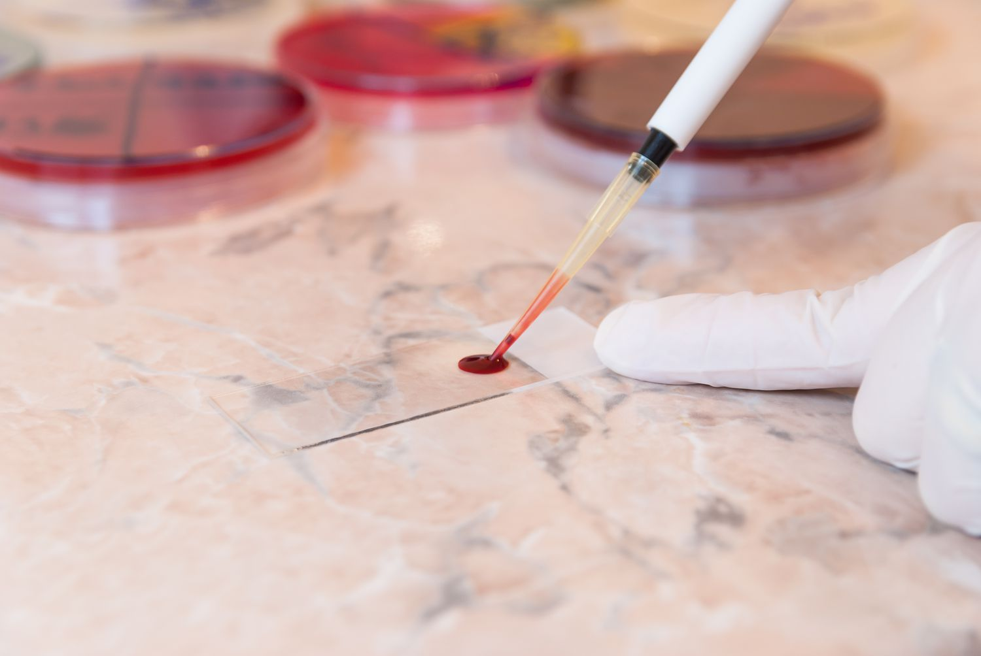
Thank you
"Giving blood is the kindest and most powerful act of kindness to humanity"

